Slide 2
Oral Statements
Oral statements or discussion during the pre-bid meeting today will not be binding, nor will it change or affect the terms or conditions within the Plans and Specifications of this Project. Changes, if any, will be addressed in writing only via an Addendum.

Slide 3
Agenda
General Information
Small, Minority, Women and Veteran-Owned Business (SMWVB Requirements)
IFB Schedule
Contract Solicitation Website
Vendor Registration & Notification (VRN)
Contract Requirements
Bid Packet Preparation
Key Reminders
Temporary Bid Opening Instructions
Contact Information
Technical Information

Slide 4
General Information
Non-Mandatory pre-bid meeting
Presentation has been posted on SAWS website
Construction services being procured through IFB
Construction Estimate: $1,071,000.00
Calendar Days: 270 days

Slide 5
Aspirational SMWB Goal
Industry | Aspirational SMWB Goal
Construction | 20%
The aspirational SMWB goal is 20% of your total bid price.
Notes:
Contracting

Slide 6
Accepted SMWVB Certification Agency
South Central Texas Regional Certification Agency
  MBE, WBE, SBE (Includes “HUB” Program)
Minimum Qualifications for SMWVB recognition:
SBE-Certified (even MBEs and WBEs)
Local office or local equipment yard

Slide 7
Good Faith Effort Plan (GFEP) FAQs
Q: Is the 20% SMWB goal mandatory?
A: No, but we ask prime contractors to do their best with good faith outreach efforts. If the goal is not met, proof of outreach efforts is required with the submittal.
Q: What if I am having trouble finding SMWB subcontractors?
A: Please email the SMWVB Program Manager with the scopes of work you are seeking. You will receive lists of local SMWVB-certified firms to contact.
Q: What if my business is SMWB-certified? Do I need to find SMWB subs?
A: If your firm is SMWVB-certified, you will most likely meet the goal. However, the GFEP is a required document, and a good faith outreach effort is still necessary.
Q: Do I need to include all my subcontractors in the GFEP or just those that qualify towards the
SMWB goal?
A: All subcontractors need to be included in the GFEP, even those that may not count towards the SMWB goal.
Q: What if I have questions about the GFEP?
A: Please contact the SMWVB Program Manager at 210-233-3420, or at Marisol.Robles@saws.org . GFEP questions can be asked at any time before the submittal is due.
Notes:
SMWB

Slide 8
Post Award: Subcontractor Payment & Utilization Reporting (S.P.U.R.) System
1. Subcontractor & Supplier Payment Tracking
2. Subcontractor and Supplier Additions or Substitutions
3. LCP Tracker
4. Must be Current and Accurate before Retainage is released https://saws.smwbe.com

Slide 9
IFB Schedule
Questions Due October 23, 2020
2:00pm (CT)
Answers Posted
October 30, 2020 5:00pm (CT)
Bids Due
November 6, 2020 2:00pm (CT)
Lowest Responsible Bidder Notified
November 2020
Board Award December 8, 2020
FTP Request Deadline
November 5, 2020 2:00pm (CT)

Slide 10
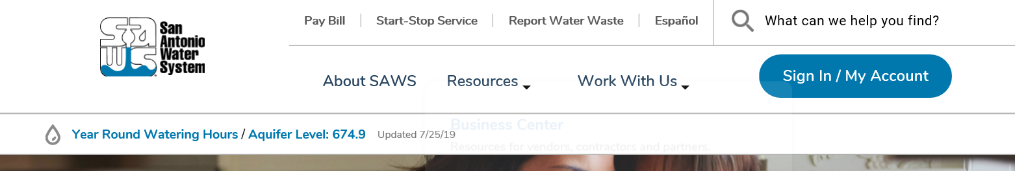
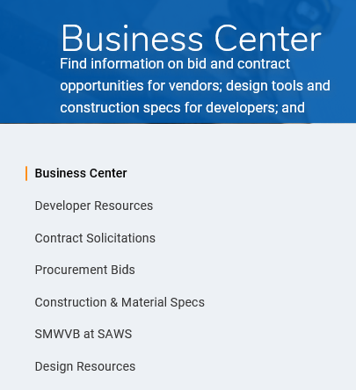
Contract Solicitations Website
To locate the Contract Solicitations website choose Resources
At the drop down menu choose Contract Solicitations.

Slide 11
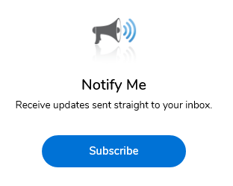
Vendor Registration & Notification (VRN)
Reasons to Register in the VRN
Receive bid notices directly in your email “Inbox”.
Download bid documents.
Subscribe to specific bids.
Receive addendum notifications.
https://apps.saws.org/Business_Center/Contractsol/

Slide 12
Contract Requirements
Prevailing Wage Rate and Labor Standards – Section 2.10 of the General Conditions
Payroll records are subject to review
Contractors to utilize LCP Tracker
Certified payroll to be submitted on weekly basis
Contractors are responsible for sub-contractor payroll
Late payrolls delay contractor payments from SAWS
Wage decisions are included within the specifications
Site visits are random and unannounced
Interviews will be conducted and will be private & confidential
All apprenticeship programs will need to be approved by Department of Labor prior to starting

Slide 13
Contract Requirements
Supplemental Conditions
Insurance requirements are found in Section 5.7 of the GCs
  Installation Floater in lieu of Builder’s Risk
  Maintain insurance coverage during the construction of this Project
Will ask for insurance prior to Board award to expedite execution of the contract
Compliant prior to executing the contract

Slide 14
Contract Requirements
Supplemental Conditions (Continued)
Apparent Low Bidder
Notified within 24 hours of Bid Opening
Thoroughly complete Statement of Bidder’s Experience form
  Projects should meet requirements identified in the solicitation
  References and contact information must be verified prior to submitting

Slide 15
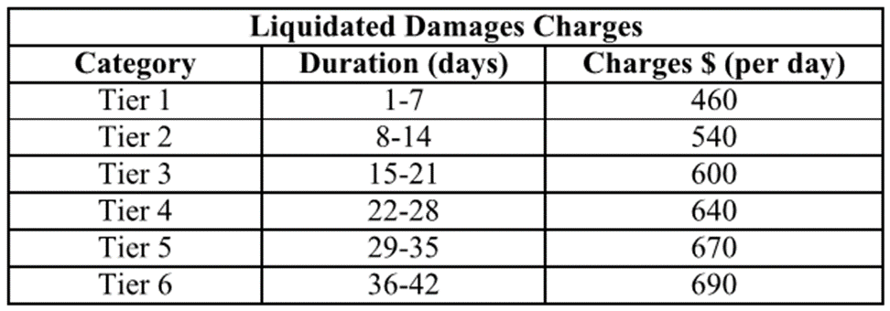
Contract Requirements
Supplemental Conditions (Continued)
Contractor shall perform the work with its own organization on at least 40% of the total original contract price which should be indicated on the Good Faith Effort Plan.
Liquidated damages will be assessed as follows for final completion extending beyond contract time:
Any days tallied after 42 days will be assessed as a Tier 6 rate.
Any days tallied after 42 days will be assessed as a Tier 6 rate.

Slide 16
Bid Packet Preparation
Utilize the Bid Packet Checklist within the specifications
Double check all mathematical calculations and verify all extensions
Ensure Mobilization and Preparing Right-Of-Way do not exceed percentage
Addendums are acknowledged on the Bid Proposals
  Check our website regularly for addendum postings
  It is possible to have multiple addendums during the time frame in addition to the scheduled final addendum

Slide 17
Key Reminders
All questions should be sent in writing to the corresponding Contract Administrator by email or fax.
Please identify the project by its associated solicitation number. CO-00364

Slide 18
Temporary Bid Opening Procedures
Bids will be submitted using SAWS’ temporary bid opening procedures
SAWS encourages and prefers the submission of electronic bids using its secure FTP site.
  Bidders should submit a request via email to obtain access to the site no later than 24 hours before the bid opening.
Or, Bidders may drop off bid; but only the required items
  Drop box is located at 2800 US Hwy 281 N, Customer Service Tower
    Enter the first set of glass double doors
    Insert into the black drop box on the wall on the left hand side
Late bids will not be accepted and will be returned unopened.
Bid Opening will be handled via WebEx only; link found in IFB

Slide 19
Contact Information
Contact Name | Title | Telephone Number | Email address
Janie Powell | Contract Administrator | 210-233-2443 | Janie.Powell@saws.org
Marisol Robles | SMWVB Program Manager | 210-233-3420 | Marisol.Robles@saws.org
REMINDER
Please be advised that Bidders are prohibited from communicating with any other SAWS staff, the Consultant, the Developer, or City of San Antonio officials regarding this IFB up until the contract is awarded as outlined in the Instructions to Bidders

Slide 20
Contract Background
Sealed bids are requested by the San Antonio Water System for the construction of approximately 4,316-linear feet (LF) of 8-inch, 1,082-lf of 10-inch, and 305-lf of 12-inch Sewer Main via Cured-In-Place-Pipe (CIPP) and Point Repairs.
Project is part of the Consent Decree.
Contractor is to become familiar with the plans, specifications, and project locations.

Slide 21
Project Sites
Site 1- El Sendero
Site 2- S. Weidner
Site 3- Highcliff
Site 4- Deerfield
Site 5- Berrycreek
Site 6- Tropical
Site 7- Hall Park
Site 8- Cambray
Site 9- Azucena
Site 10- San Simeon
Site 11- Medina Base
Site 12- Cedarhurst
Site 13- Mai Kai
Site 14- Bane
Site 15- Doolittle

Slide 22
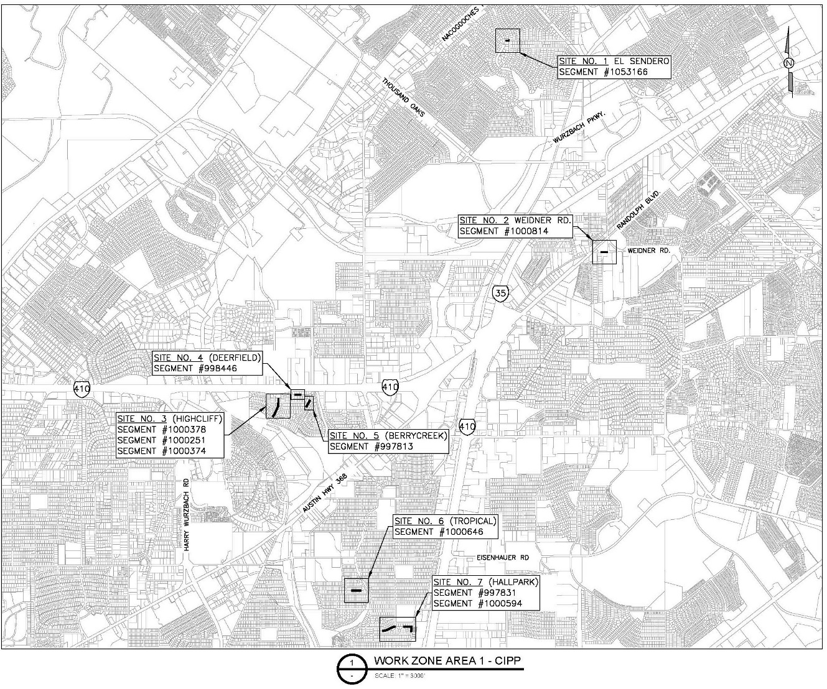
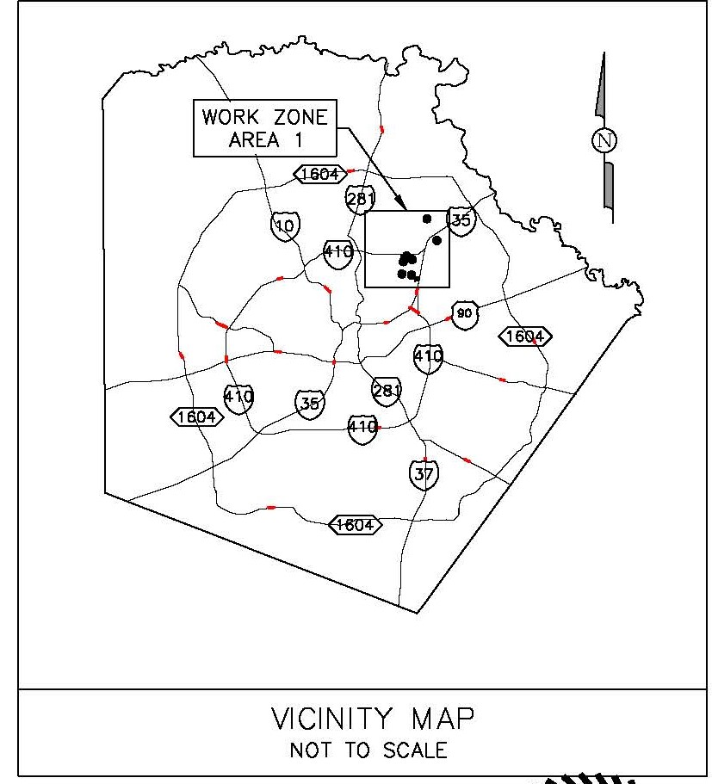
Location (Work Zone 1)

Slide 23
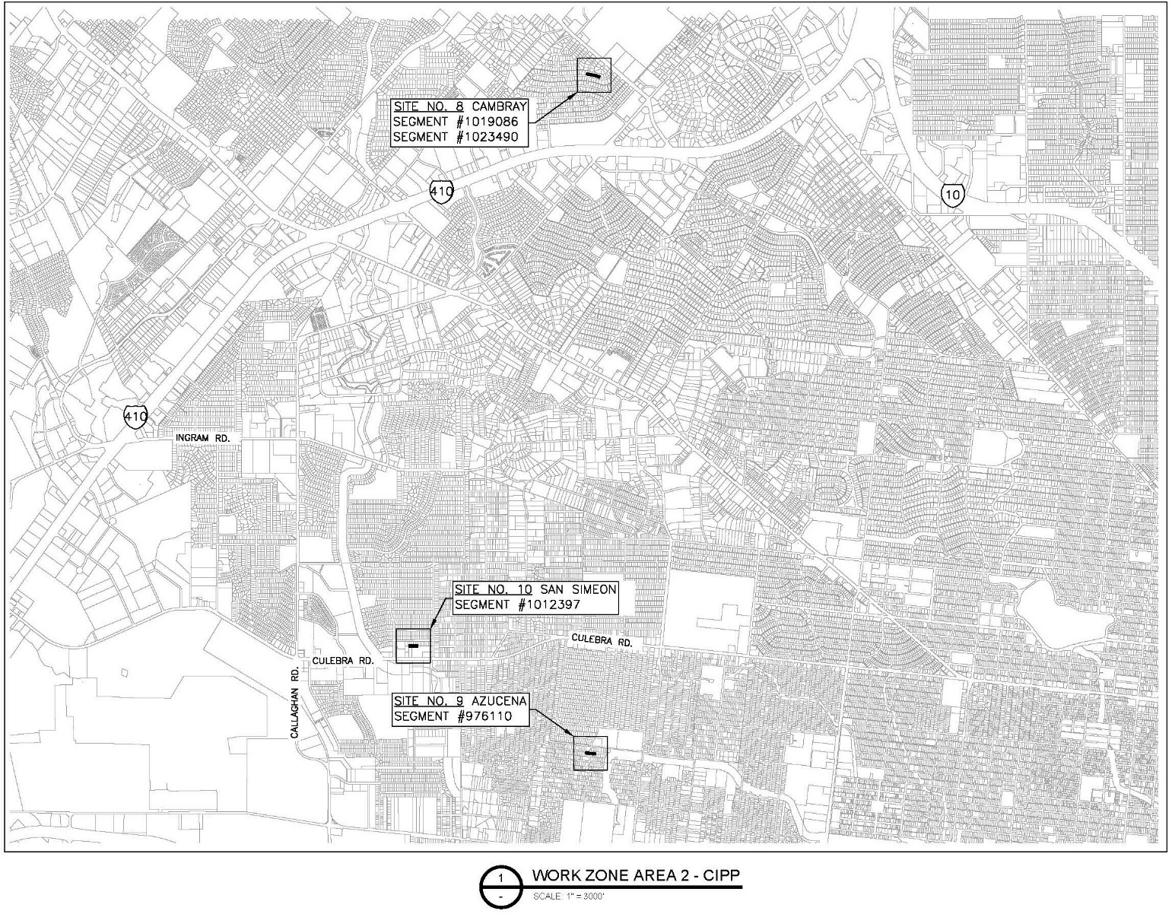
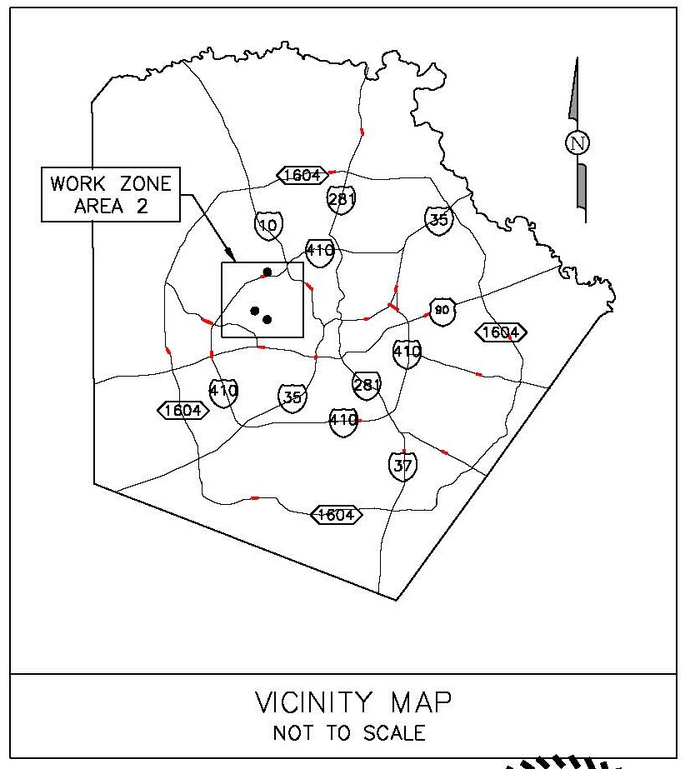
Location (Work Zone 2)

Slide 24
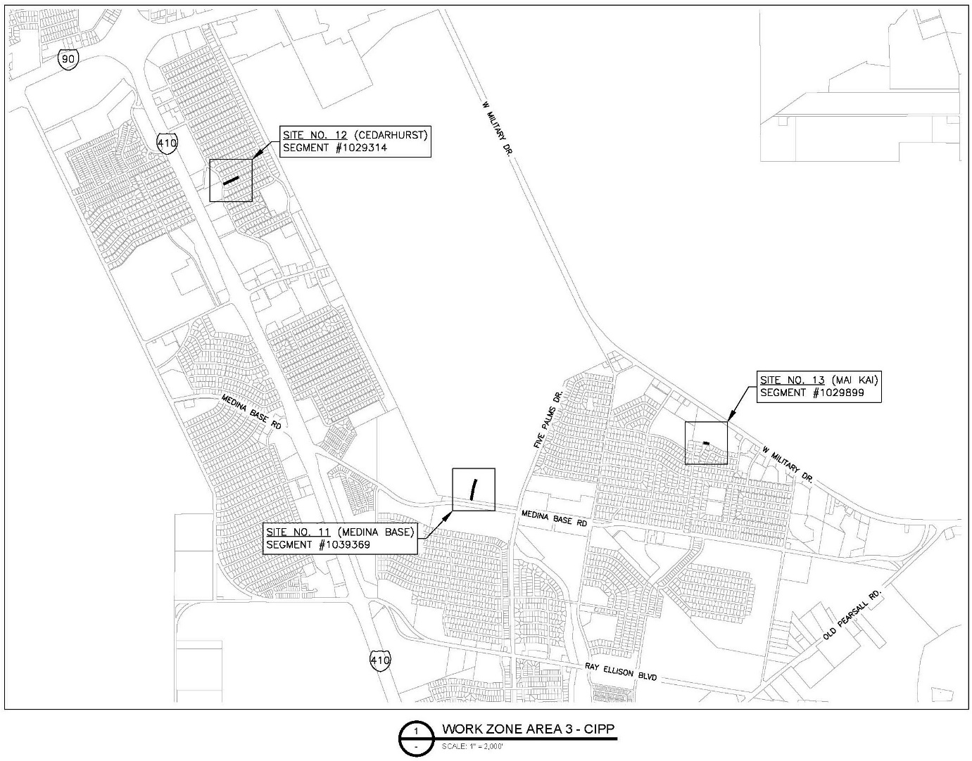
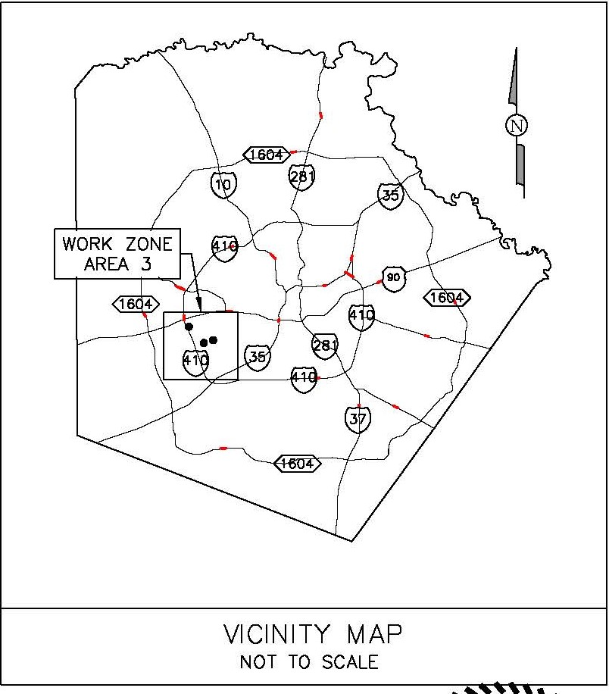
Location (Work Zone 3)

Slide 25
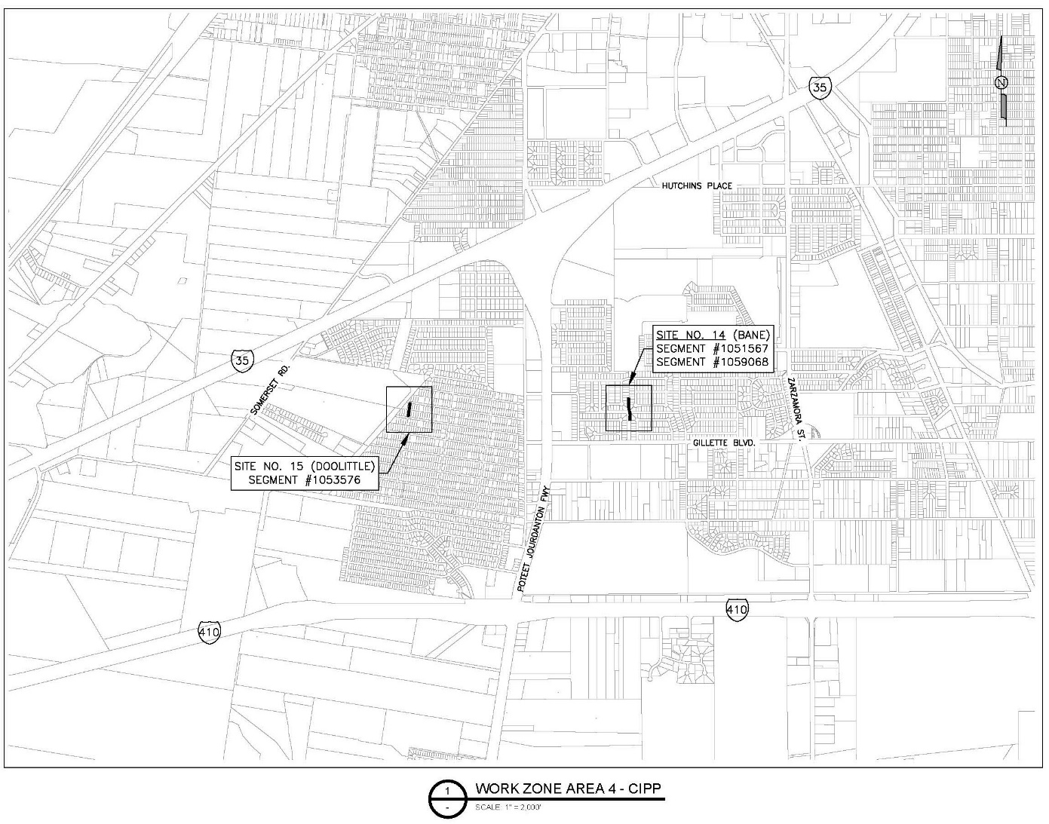
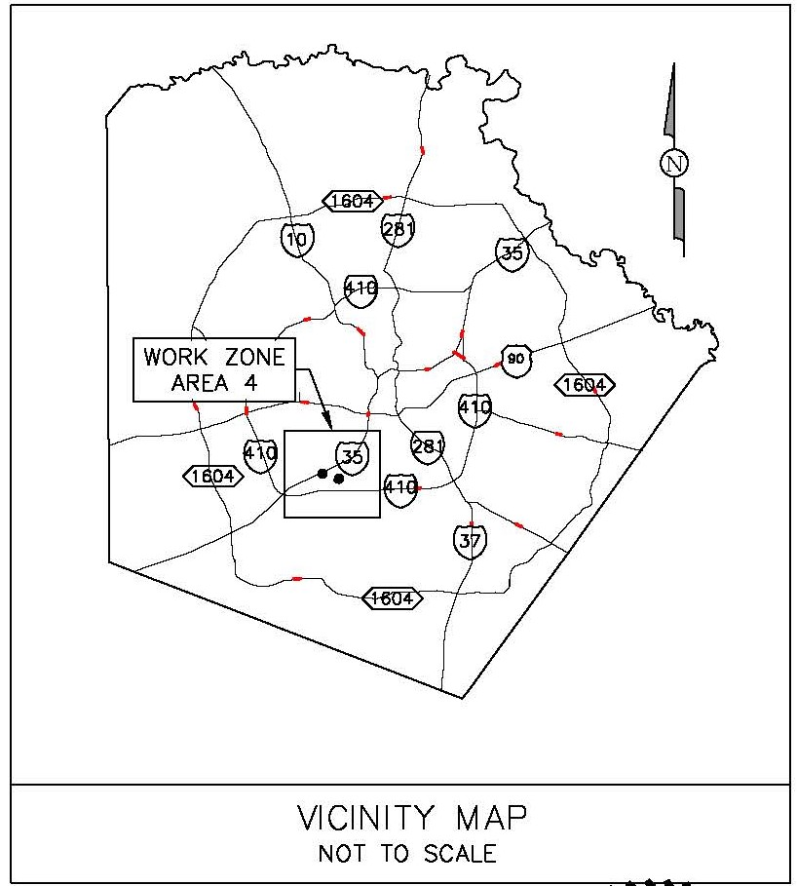
Location (Work Zone 4)

Slide 26
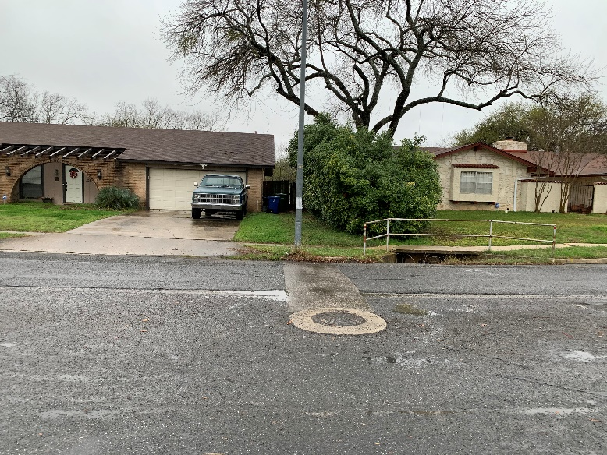
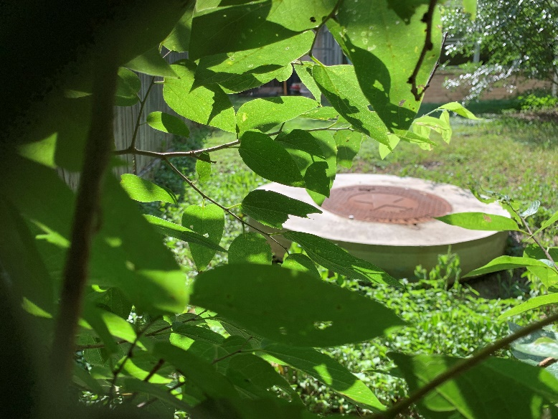
Project Summary
Site 1- El Sendero (CIPP)
  Rehabilitate approximately 141-lf of 8-inch Sewer Main
  Rehabilitate 2 MHs
  Street ROW & 10-ft Sewer Easement (Residential Property)

Slide 27
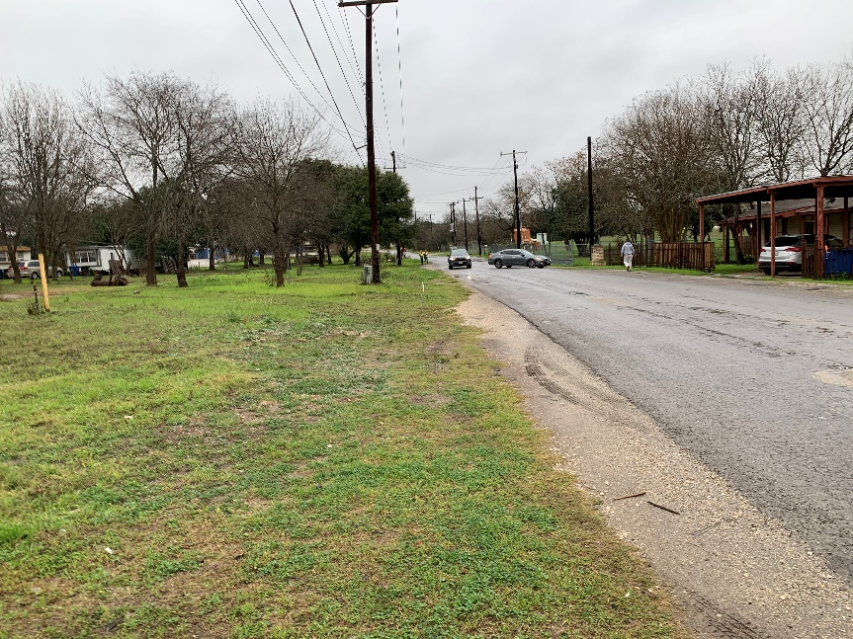
Project Summary
Site 2 – S. Weidner Rd.
  Rehabilitate 306-lf of 8-inch Sewer Main and Point Repair(s)
  Replace one (1) MH and Rehabilitate one (1) MH
  Sewer lateral Reconnection
  Street ROW (S. Weidner Rd.)

Slide 28
Project Summary
Site 3- Highcliff Dr.
  Rehabilitate 852-lf of 8-inch Sewer Main & Point Repair(s)
  Rehabilitate three (3) MH
  Sewer lateral Reconnection
  Street ROW and 16-ft Utility Easement (Private Residential Properties).
    Construction Right-of-Entry/Work Areas
    Remove and Replace Fencing/Temporary Fencing Requirements

Slide 29
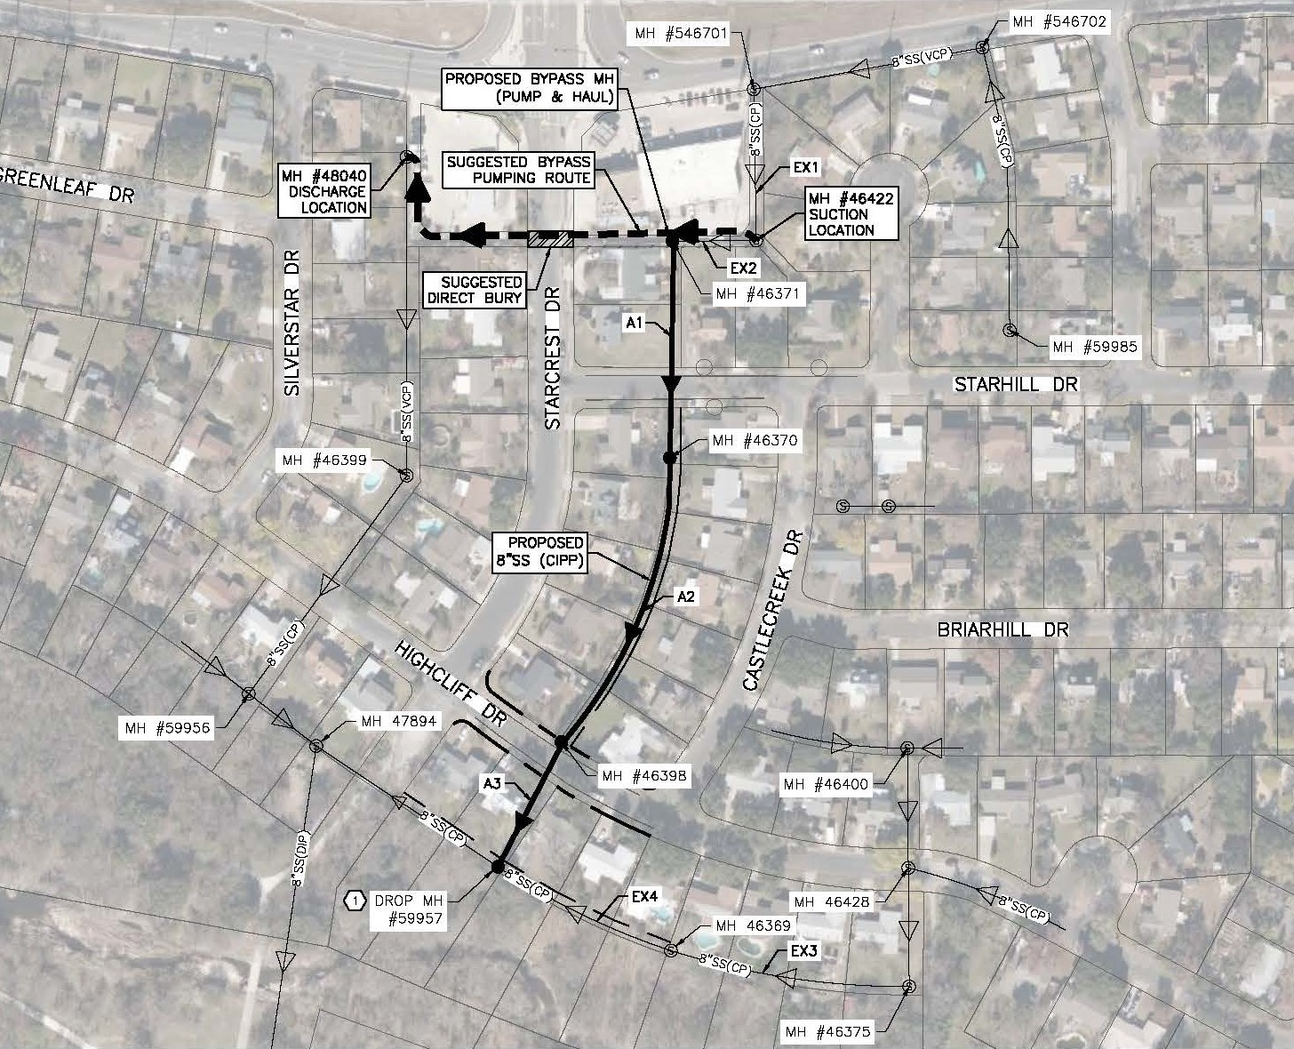
Site 3- Highcliff (Accessibility)

Slide 30
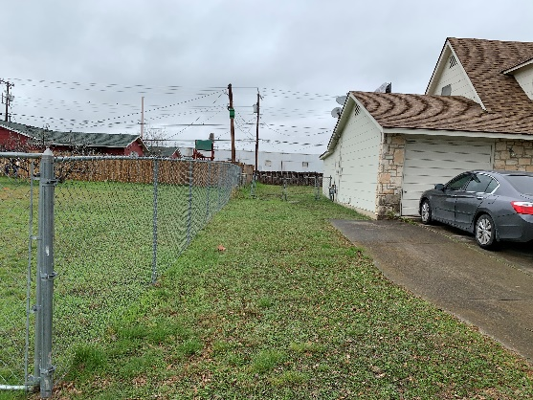
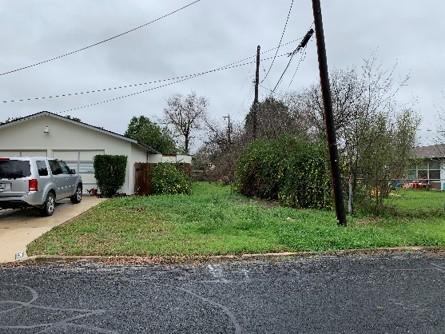
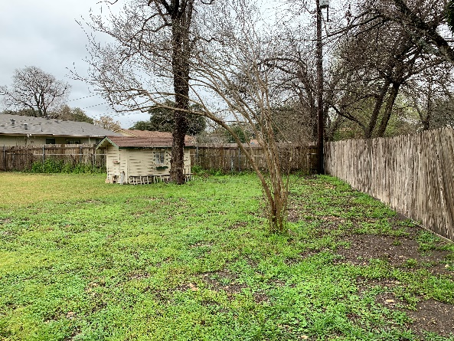
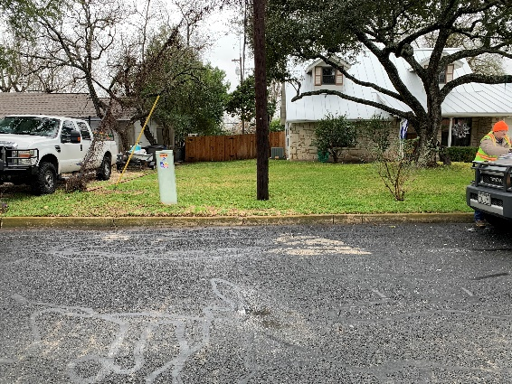
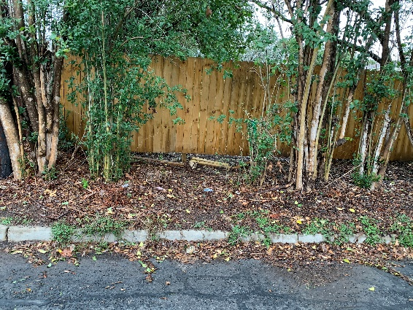
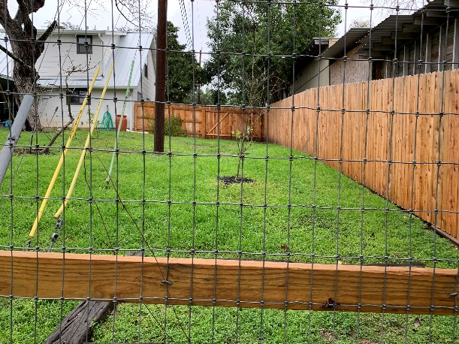
Site 3-Highcliff (Pictures)
  Strahill Dr (north)
  Starhill Dr. (south)
  8323 Castlecreek
  Highcliff Dr. (south)
  Highcliff Dr. (north)
  Salado Creek (north)

Slide 31
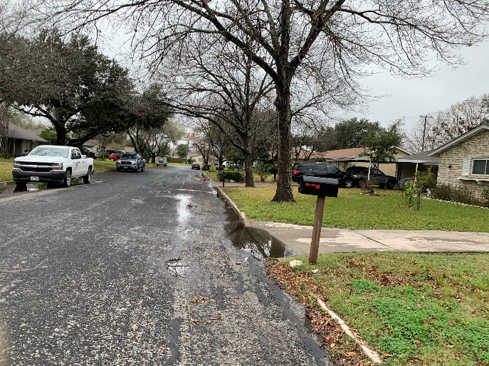
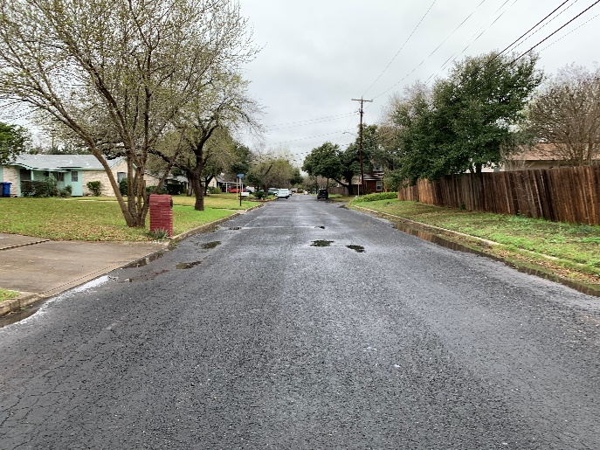
Project Summary
Site 4- Deerfield
  Rehabilitate 288-lf of 8-inch Sewer Main & Point Repair(s)
  Rehabilitate two (2) MH’s
  Sewer lateral Reconnection
  Street ROW
Site 5- Berrycreek
  Rehabilitate 342-lf of 8-inch Sewer Main & Point Repair(s)
  Rehabilitate two (2) MH’s
  Tree Protection
  Sewer lateral Reconnection
  Street ROW

Slide 32
Project Summary
Site 6- Tropical
  Rehabilitate 400-lf of 8-inch Sewer Main
  No Point Repairs
  Rehabilitate two (2) MH’s
  Sewer lateral Reconnection
  16-ft Utility Easement (Private Residential Property)
    Construction Right-of-Entry/Work Areas
    Remove and Replace Fencing/Temporary Fencing Requirements

Slide 33
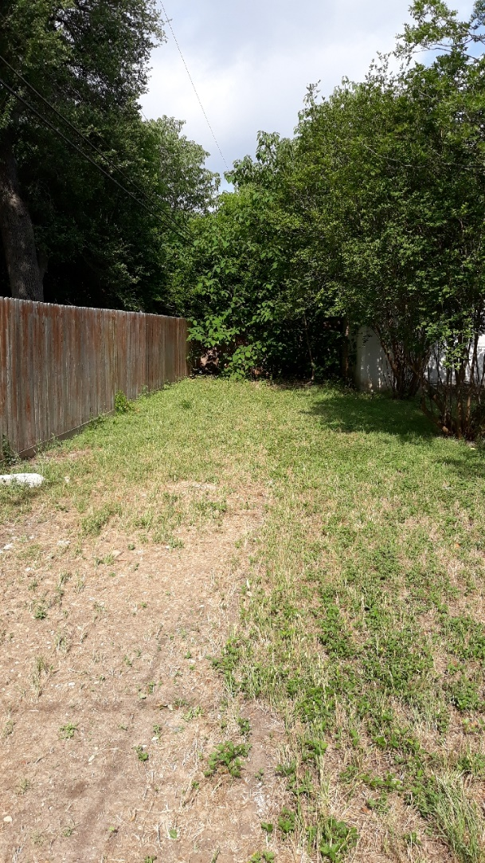
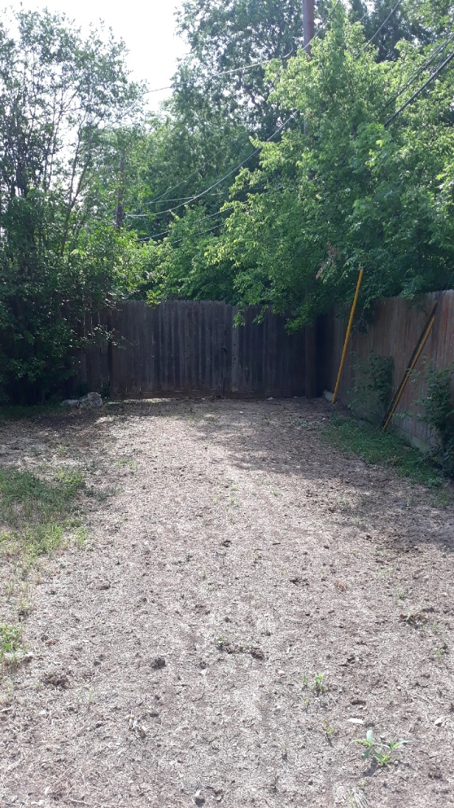
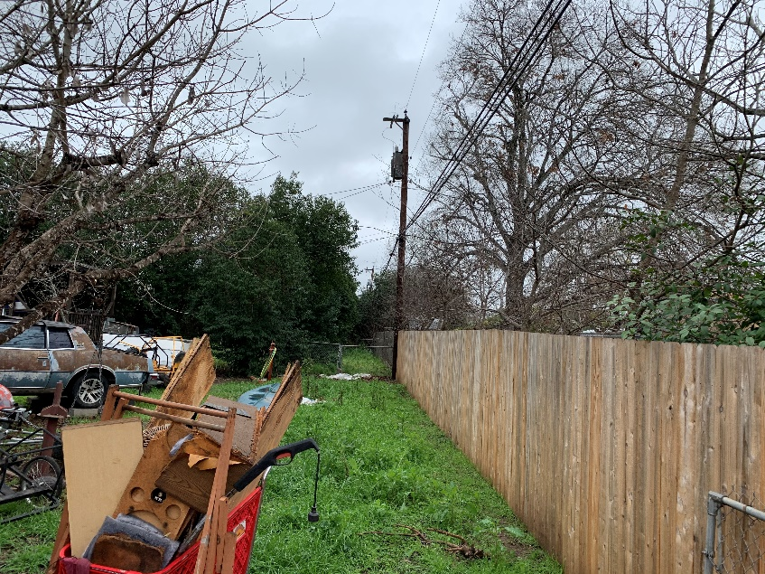
Site 6-Tropical(Pictures)
  Palm Bay Dr. (West)
  4134 Bikini
  4134 Bikini

Slide 34
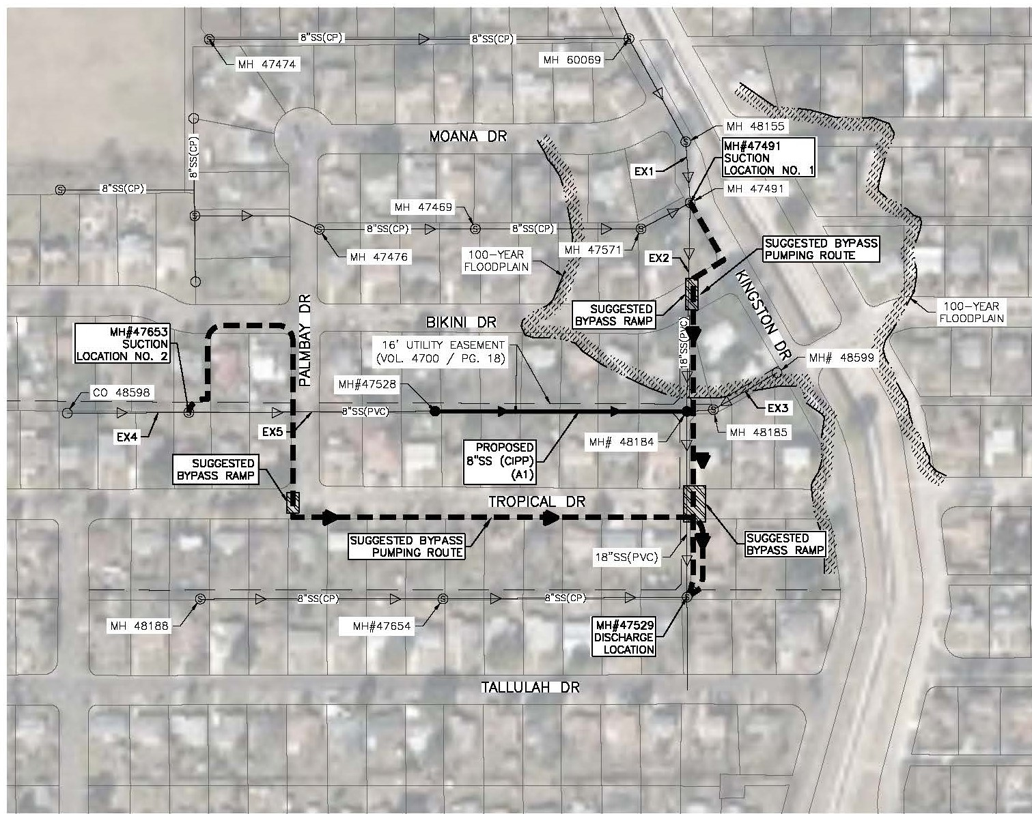
Site 6- Tropical (Accessibility)

Slide 35
Project Summary
Site 7- Hall Park
  Rehabilitate 510-lf of 8-inch Sewer Main & Point Repair(s)
  Rehabilitate two (2) MHs
  Sewer Lateral Reconnection
  Tree Protection
  16-ft Utility Easement (Private Residential Property)
    Construction Right-of-Entry/Work Areas
    Remove and Replace Fencing/Temporary Fencing Requirements

Slide 36
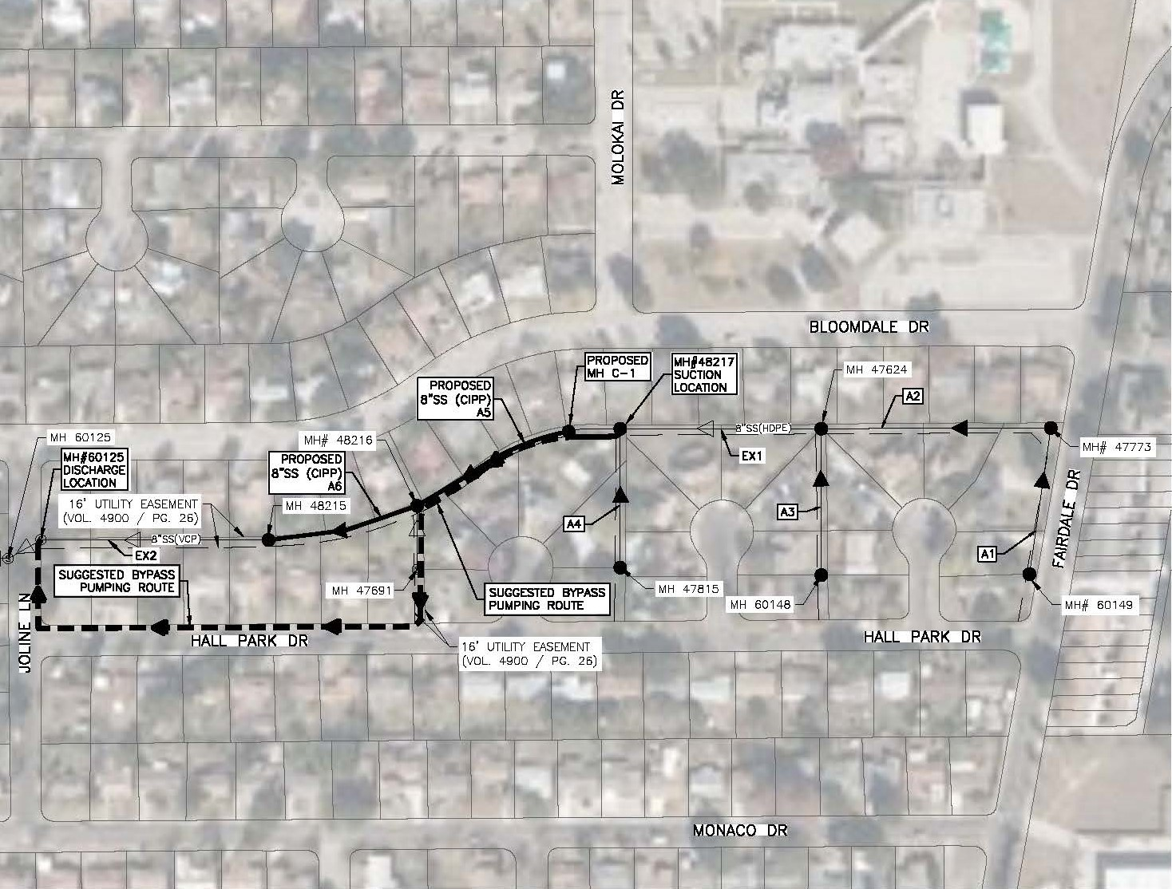
Site 7- Hall Park (Accessibility)

Slide 37
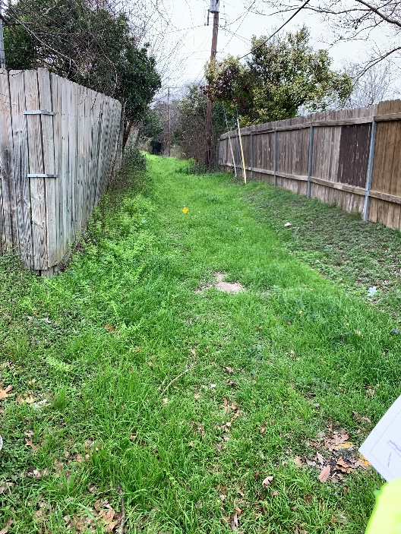
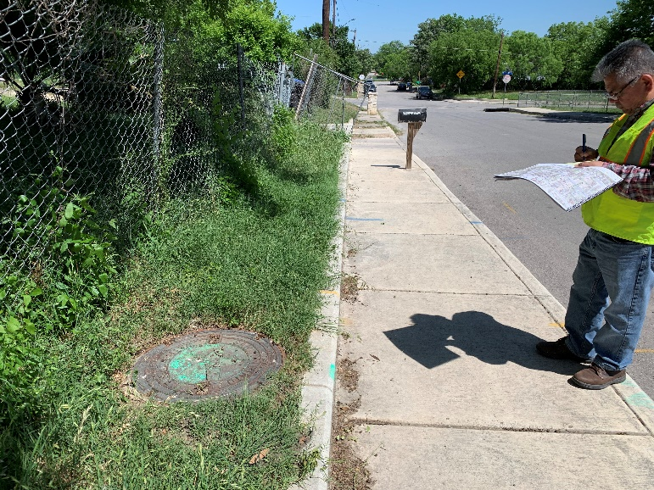
Project Summary
Site 8- Cambray
  Rehabilitate 421-lf of 8-inch Sewer Main & Point Repair(s)
  Rehabilitate one (1) MH, Re-construct one (1) MH,
  and replace one (1) MH
  Sewer Lateral Reconnection
  16-ft Alley ROE
Site 9- Azucena
  Rehabilitate 298-lf of 8-inch Sewer Main & Point Repair(s)
  Rehabilitate two (2) MH’s
  Sewer Lateral Reconnection
  Street ROW

Slide 38
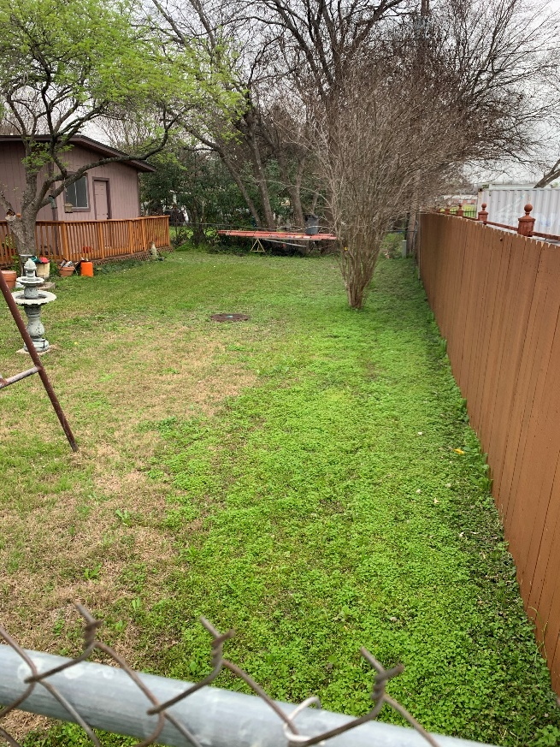
Project Summary
Site 10- San Simeon
  Rehabilitate 275-lf of 8-inch Sewer Main & Point Repair(s)
  Rehabilitate two (2) MH’s
  Sewer Lateral Reconnection
  16-ft Utility Easement (Private Residential Properties)
    Construction Right-of-Entry/Work Areas
    Remove and Replace Fencing/Temporary Fencing

Slide 39
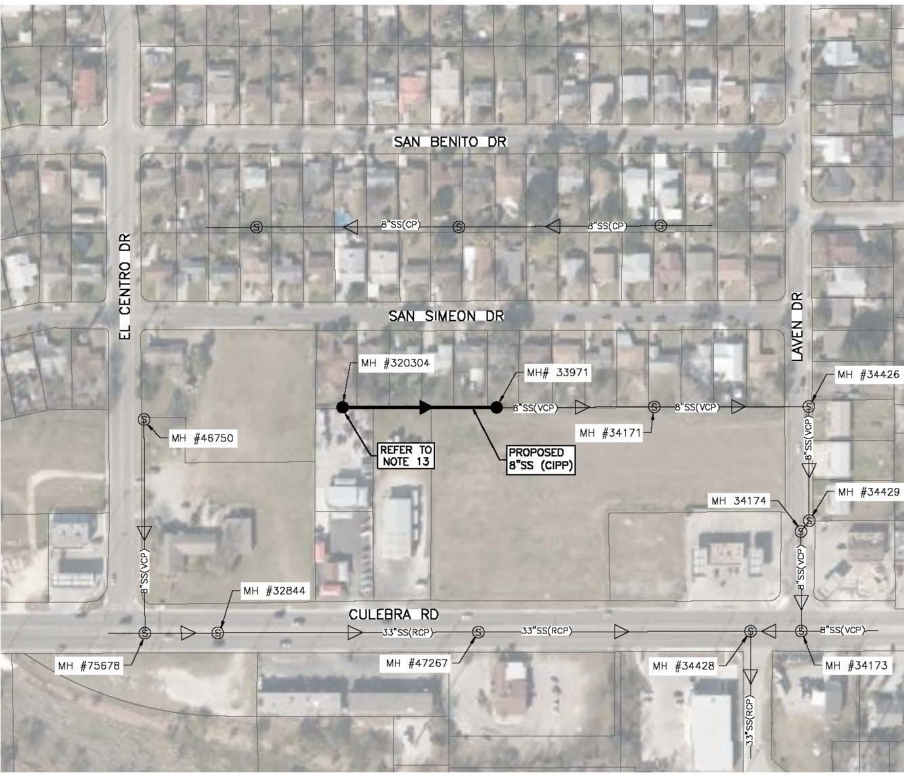
Site 10- San Simeon (Accessibility)

Slide 40
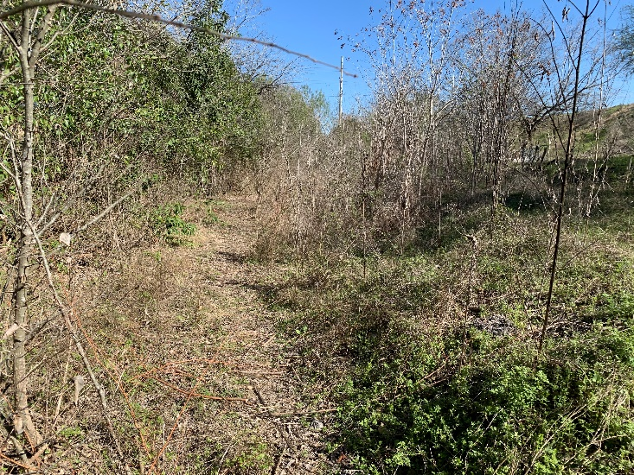
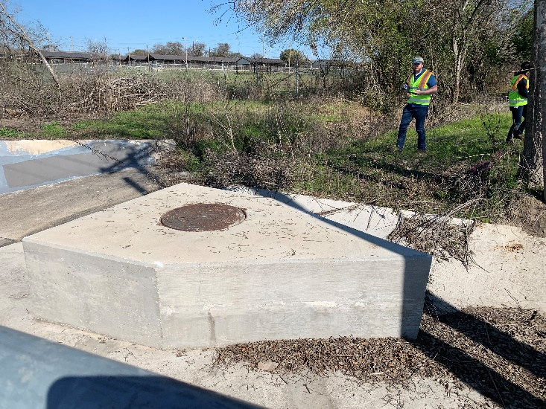
Project Summary
Site 11- Medina Base
  Rehabilitate 478-lf of 8-inch Sewer Main & Point Repair(s)
  18-ft of 8-inch Sanitary Sewer (Open Cut)
  Re-construct one (1) MH and install one (1) new MH
  Tree removal (outside COSA ROW)
  100-ft Lackland AFB Railroad Spur/Drainage Channel
    Construction Right-of-Entry/Work Areas

Slide 41
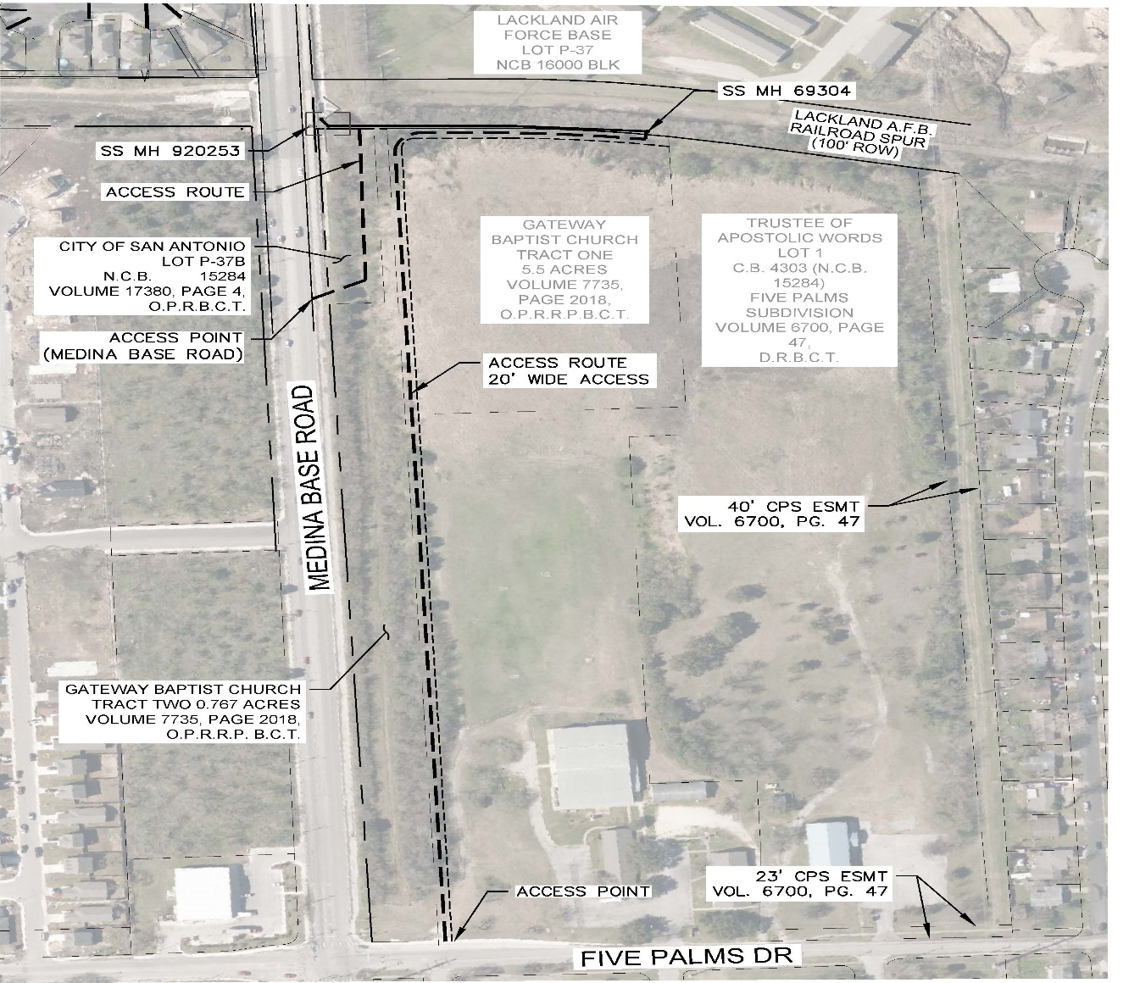
Site 11- Medina Base (Accessibility)

Slide 42
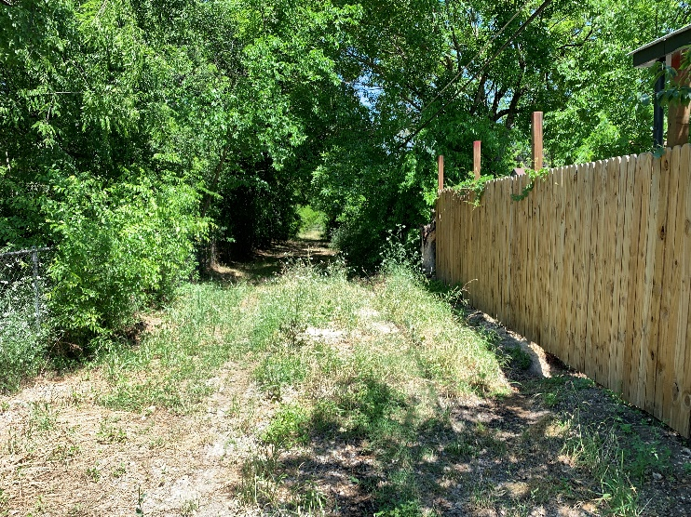
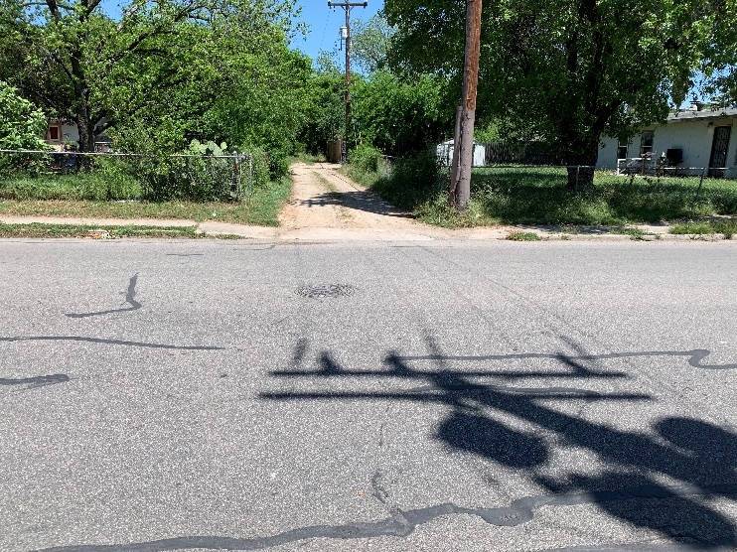
Project Summary
Site 12- Cedarhurst
  Rehabilitate 390-lf of 8-inch Sewer Main & Point Repair(s)
  Rehabilitate two (2) MH’s
  COSA Drainage Project (Completion Date: June 5, 2021)
  16-ft Alley ROW

Slide 43
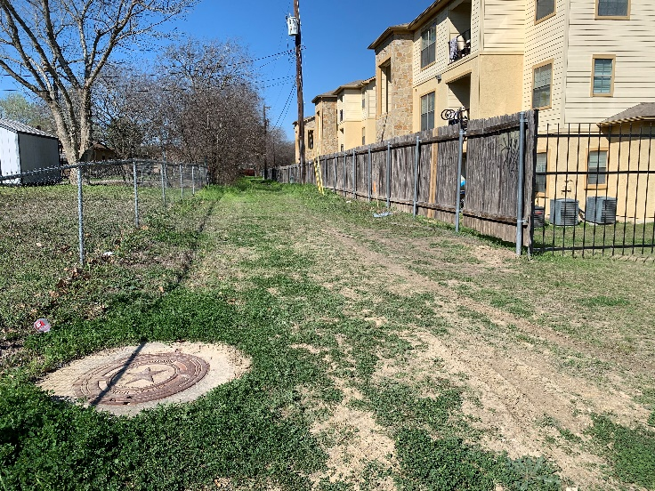
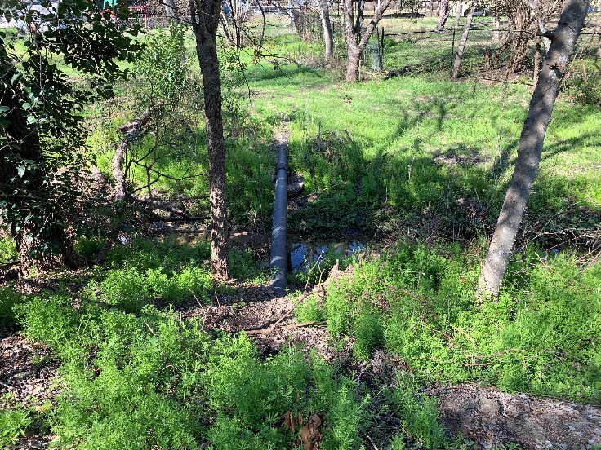
Project Summary
Site 13- Mai Kai
  Rehabilitate 127-lf of 8-inch Sewer Main
  Rehabilitate two (2) MH
  Cast Iron Pipe/Aerial Crossing
  16-ft Utility Easement
    Construction Right-of-Entry/Work Areas
  Site accessible via Merry Oaks Dr.

Slide 44
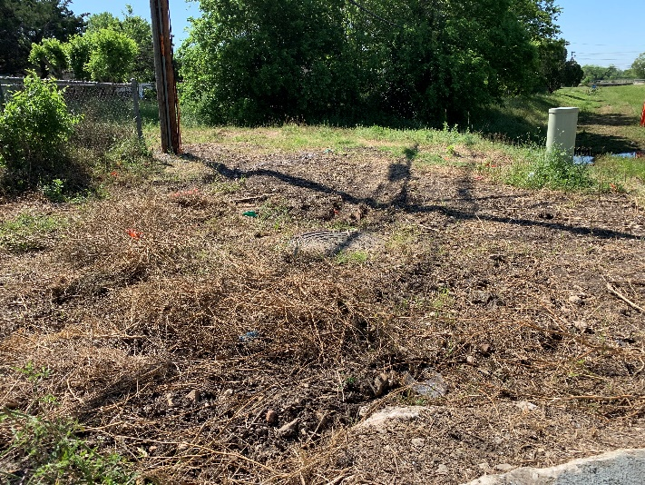
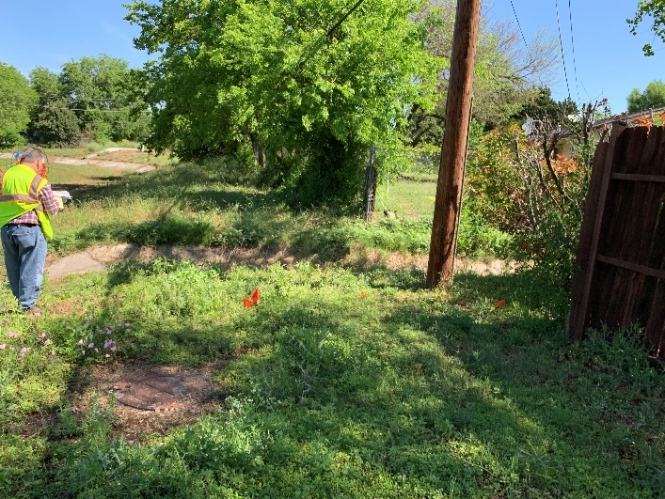
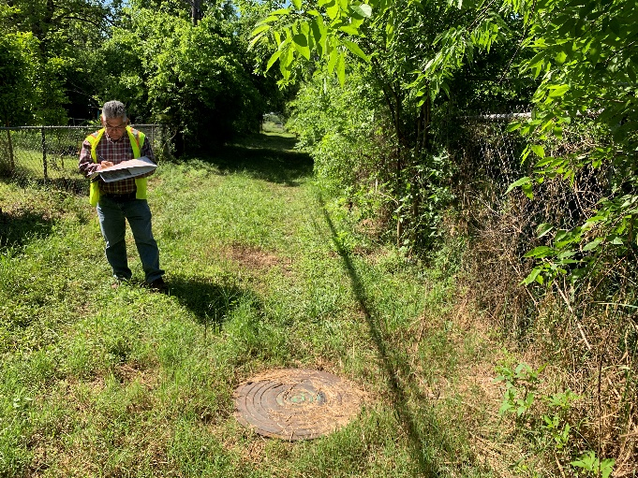
Project Summary
Site 14- Bane
  Rehabilitate 520-lf of 8-inch Sewer Main
  Rehabilitate three (3) MH’s
  Concrete Channel Reconstruction Required
  16-ft Utility Easement/69 Drainage Channel Easement

Slide 45
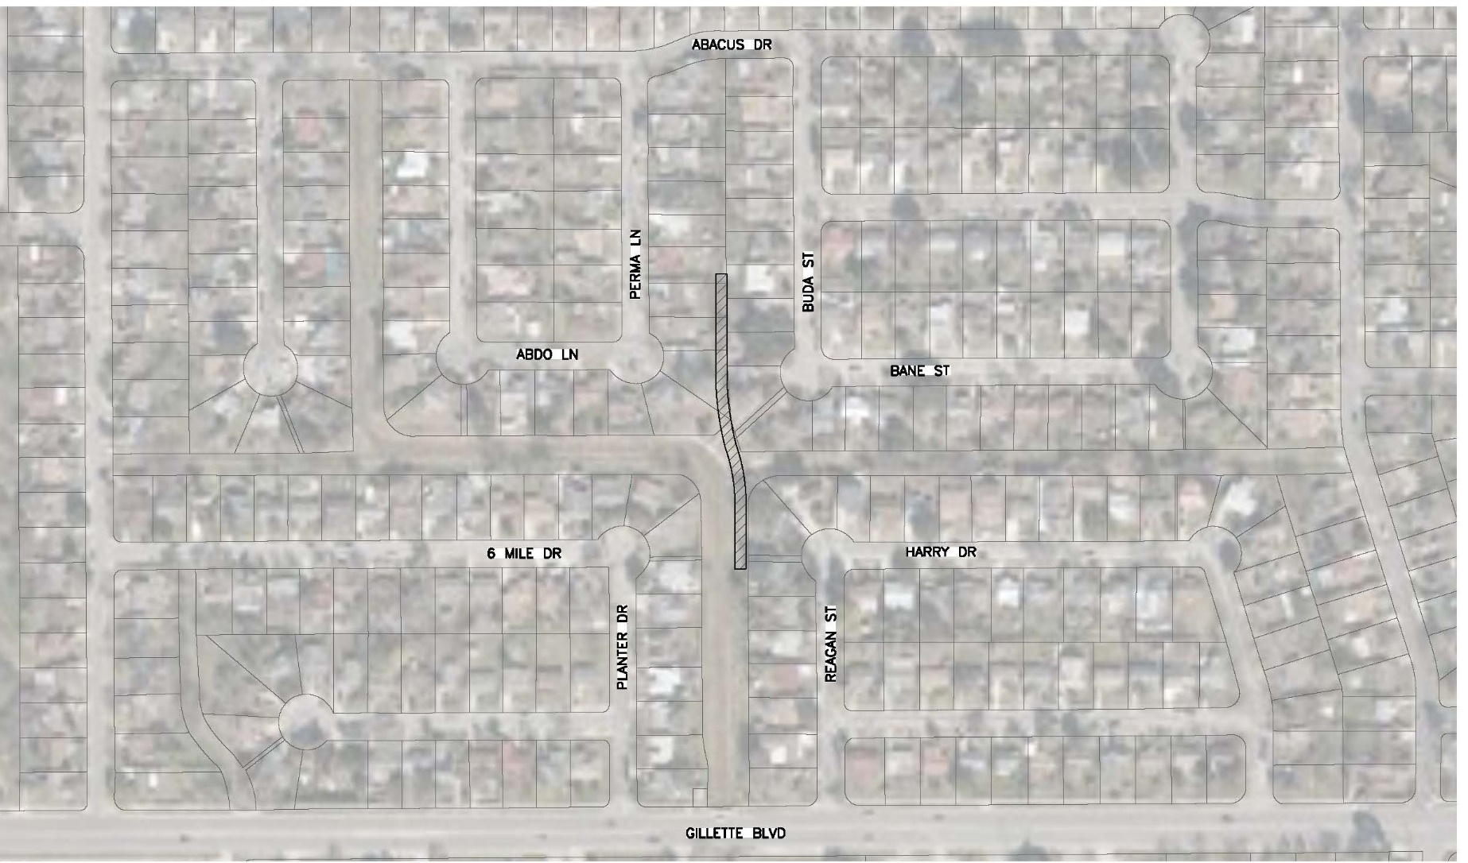
Site 14- Bane (Accessibility)

Slide 46
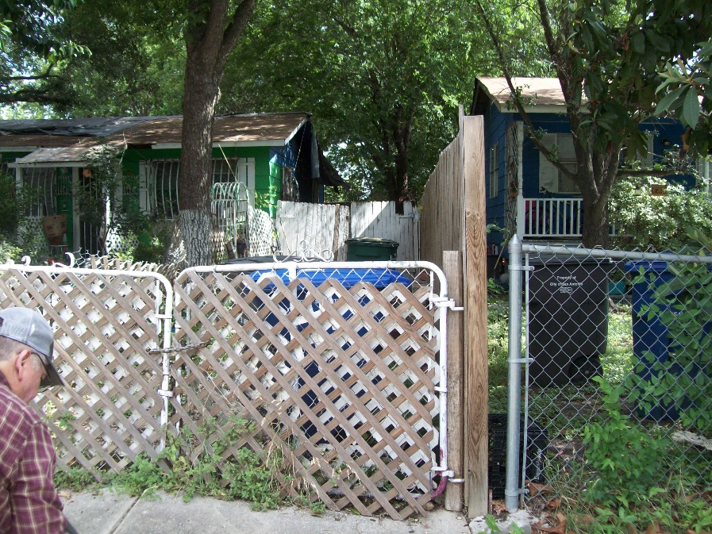
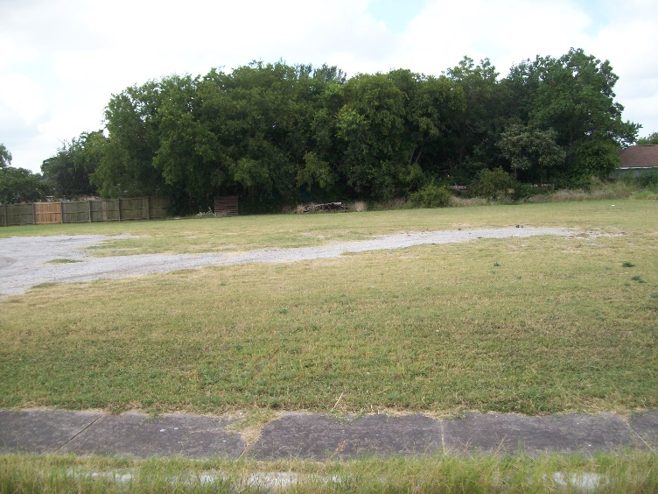
Project Summary
Site 15- Doolittle
  Rehabilitate 320-lf of 8-inch Sewer Main
  Point Repair (140-ft)
  Rehabilitate two (2) MH’s
  16-ft Utility Easement
  Access via Spaatz St.
  Access via Doolittle St.
  Doolittle St. (north)
  Spaatz St. (south)

Slide 47

QUESTIONS
Reminder: Oral statements or discussion during the pre-bid meeting today will not be binding, nor will it change or affect the terms or conditions within the Plans and Specifications of this Project. Changes, if any, will be addressed in writing only via an Addendum.

